Slide 1
Assignment 4: Rent-a-Reel
By Darren Husting, AJ Plumlee, and David Li

Slide 2
Design Philosophy
One object to rule them all
Only need Inventory class to create an inventory
Flexibility in building an entity
3 methods of inputting into an inventory
File
Command
API
Scaling to handle variation and customization
Backing up

Slide 3
The Concept
Prompt was built for polymorphism
Genre -> Action, Comedy, etc
Problems with that implementation
Not Scalable, too many classes
Different Stores, Different Sort Methods?
Lowering the skill gap for input
Not a programmer, no problem!
Expanding market potential
Different Products (Hardware, video games, etc)
Renting or Buying (Food, hardware, etc)

Slide 4
Application Flow
Create an Inventory object
Create a product (abstract)
Media implementation already provided. (Can be extended to any product)
Media can be DVDs, VHS, Bluray, etc
Create a genre for that product
Give it a name, a way to parse, and a way to sort
Create a movie for that genre
Give it a product, a genre, and all the details

Slide 5
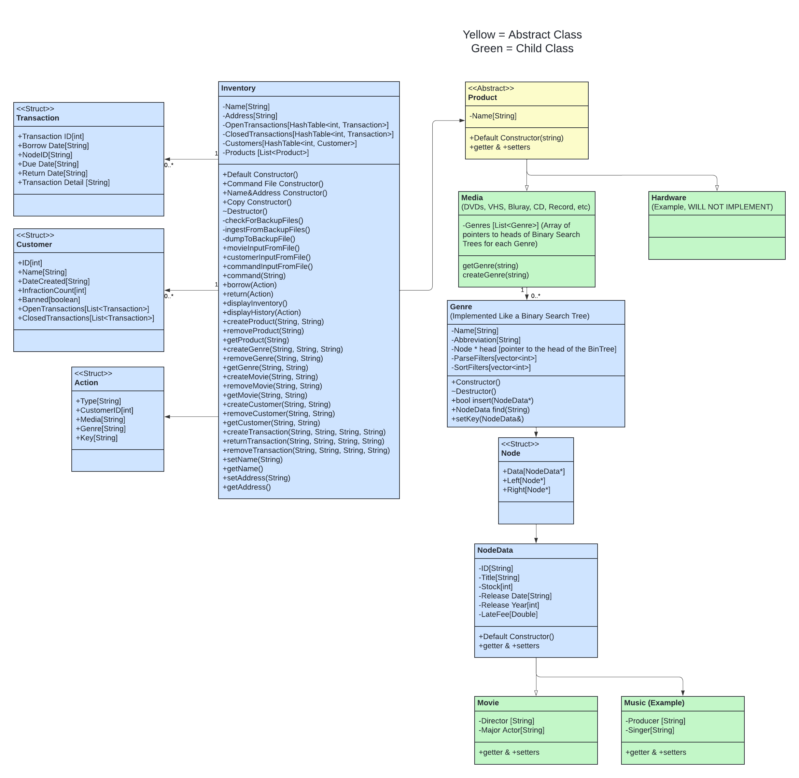
UML Diagram

Slide 6
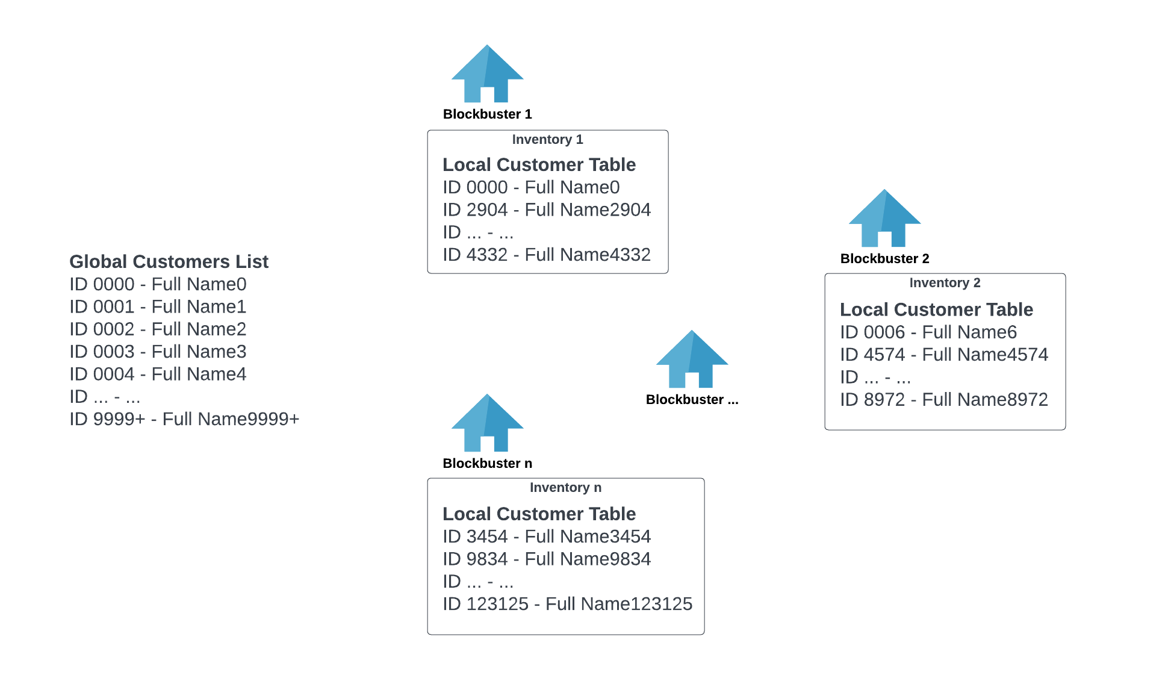
Inventory Context

Slide 7
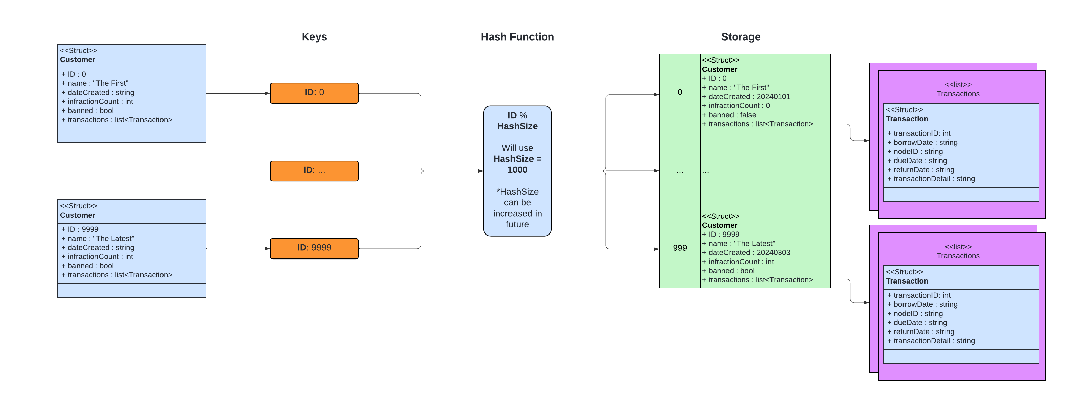
Hash Table Design

